Slide 1



Jobs and Salaries in Data Fields
View in Power BI

Slide 2
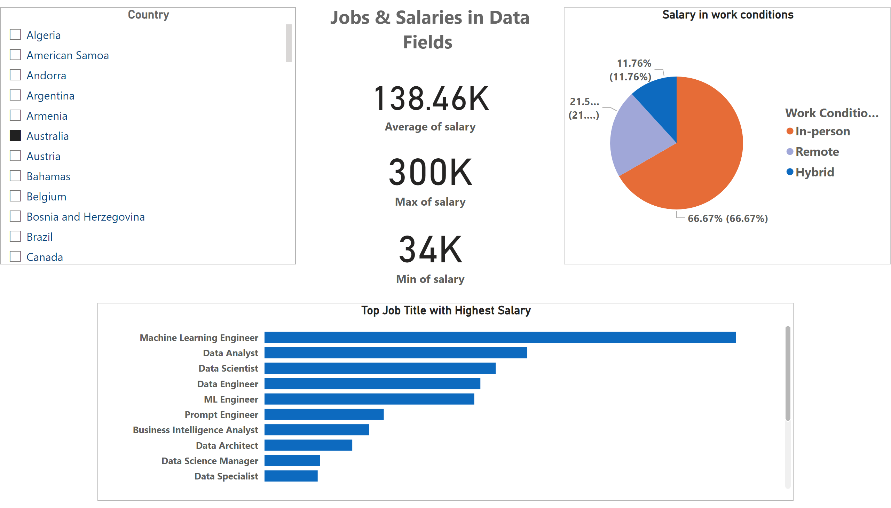
Page 1
Notes:
Top Job Title with Highest Salary
No alt text provided
card
No alt text provided
textbox
No alt text provided
card
No alt text provided
card
No alt text provided
Country
No alt text provided
Salary in work conditions
No alt text provided

